Slide 1
Chicago Crime Prediction Analysis DSC680-Appled Data Science Project 1 - Milestone 3 – Final Presentation
Abdul Basit
abasit@my365.bellevue.edu

Slide 2
Background
Cities like Chicago have had high crime rates for a long time now. Understanding the trends and basis of which may help us to reduce the same in the future.
Fbprophet is robust in the sense that it handles missing data, and dramatic changes in the dataset and is efficient in handling outliers. Using the fbprophet library, we can forecast any number of days in the future.
The primary purpose of the paper is to develop an accurate and robust fbprophet model to predict the crime rates of Chicago and map out the trends to help better understand which crimes are committed the most and during which time of the year.

Slide 3
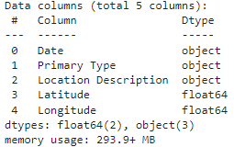
Dataset
The Chicago Crime dataset contains a summary of the reported crimes occurred in the City of Chicago from 2001 onwards. I have used data from 2010 onwards so I can clearly visualize the crime situation for past 12 years.
Dataset has been obtained from the Chicago Police Department's CLEAR (Citizen Law Enforcement Analysis and Reporting) system.
Table below shows how the datatypes and details.

Slide 4
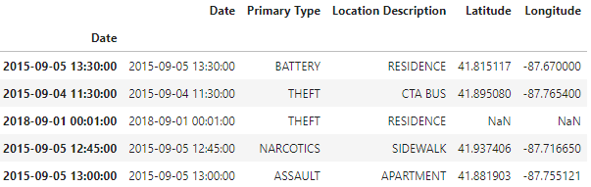
Data Exploration & Transformation
Dataset consists of 770k rows and 22 columns spanning across 12 years but I have selected only 5 fields Date, Primary Type, Location Description, Latitude & Longitude fields for effective visualization.
Identify missing values and their percentage to gauge how accurate our data will be once we start to generate charts and predictions. Those data points need to be removed.
Fbprophet requires a specific type of format for the datetime field hence it is important for it to be transformed in that specific format. The format required should be YYYY-MM-DD HH:MM:SS

Slide 5
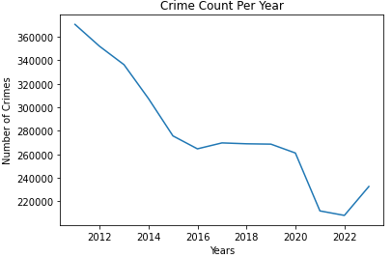
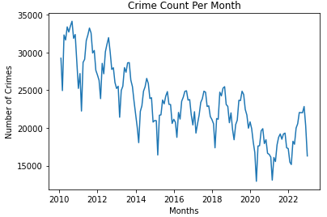
Data Preparation & Visualization
The yearly distribution of the number of crimes committed when data is resampled according to year. The overall crime rate is decreasing over time until 2020 where it was stable and was on the rise last year.
The monthly distribution is showing a similar trend until year 2020 where crime rate started to rise.
Scatter Plot Offense and defense index

Slide 6
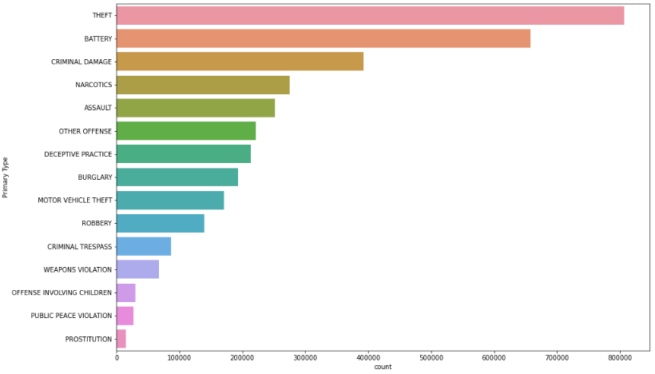
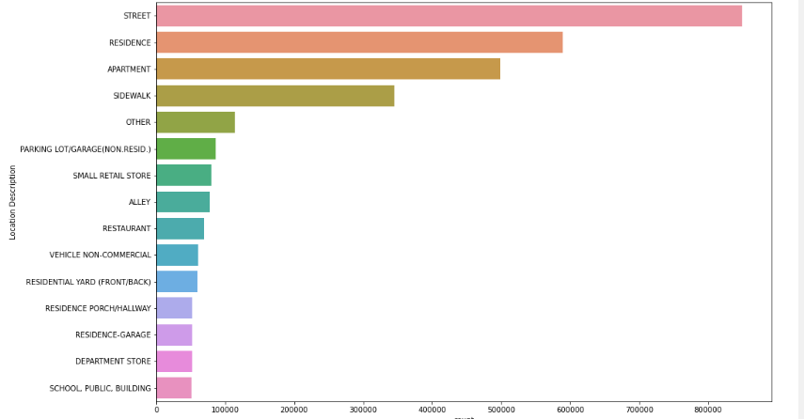
Data Visualization(2)
The top 15 crimes committed in Chicago along with their respective count is showing Theft on top.
Top 15 places where crime has been committed shows that crimes on the streets are on the top by a difference of 202k with Residences on the second spot

Slide 7
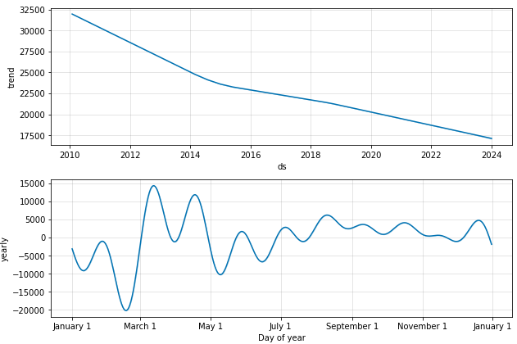
Prediction Results for 2024
Using FBProphet we have successfully predicted the crime rate for next year. We can conclude that the overall crime rate is decreasing over time and it should be expected to decrease further in the future.
There are variations in the 1st part of the year which means seasonality is strong and then we can see a stable trend in mid and end of year

Slide 8
Prediction Results for 2025
Using FBProphet we have successfully predicted the crime rate for 2025 as well. We can observe a similar trend year over year
Also the yearly trend in variations is still the same as 2024

Slide 9
Conclusion
On May 31, 2020, Chicago had experience a brutal day with 18 murders committed. This day was part of a three-day weekend that saw 85 shootings in the city. Reports indicate that the victims were of various ages and occupations. The violence was framed by the George Floyd protests, but researchers said it was unheard of and unable to be contextualized.
Gun laws have become lenient in the past 2 years in the State of Illinois and as you can see the yearly trend was stable rather that decreasing since the end of 2020.

